Slide 1
Initial Project Proposal
UAV-based post-disaster scene understanding using a hybrid single-multi-stage ensemble network with GAN-aided semantic segmentation
-Abhishek Manoharan, Nishanthini S, Vamsi Raju M

Slide 2
Problem Statement
Post-disaster scene understanding frameworks are becoming increasingly crucial in search and rescue operations and damage assessment initiatives. The use of UAVs provides an efficient method to complete the task of scene understanding.
However, complex environments present in post-disaster scenarios make it difficult for UAVs to detect humans or objects accurately. Moreover, inefficient object detection mechanisms lead to low accuracy and a long time for object detection tasks.
Hence, to mitigate these issues, we propose a UAV-based scene understanding scheme involving a GAN-aided semantic segmentation mechanism that classifies objects present in the visual scope of the UAV using a 3D reconstruction from thermal images of the scene and pixel-level prediction.
Furthermore, an ensemble network consisting of a combination of single-stage and multi-stage detectors, namely the CenterNet and Cascade R-CNN mechanisms, is to be used to improve the performance of the detection model.

Slide 3
Objectives
To develop an efficient post-disaster scene understanding framework using UAVs for search and rescue operations.
To implement a hybrid single-stage and multi-stage ensemble network comprising of the CenterNet and Cascade R-CNN mechanisms to combine the benefits of both and decrease the high false negative rate of multi-stage mechanisms, improving the performance of single-stage detectors.
To devise a 3D scene-reconstruction mechanism using thermal images obtained from the UAV to map and extract useful information from the scene.
To deploy a Generative Adversarial Network (GAN) denoiser-aided semantic segmentation framework to improve the detection of small and dense objects in post-disaster conditions.

Slide 4
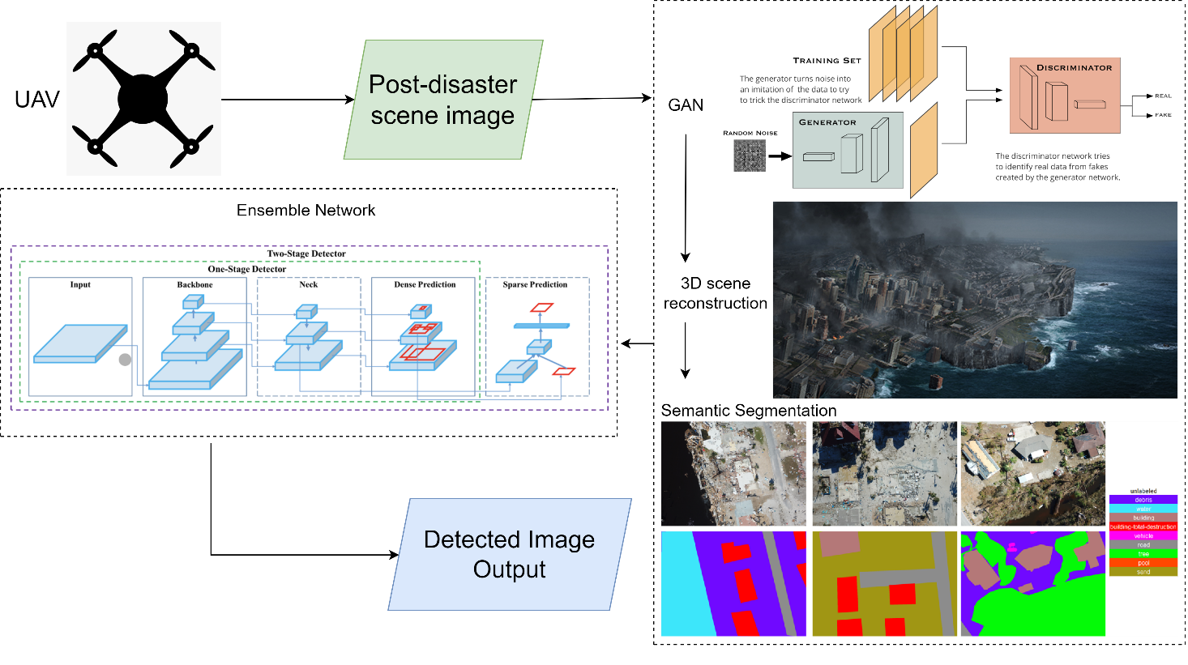
High level architecture diagram

Slide 5
Novel implementation
The implementation of a combined GAN and Semantic Segmentation pre-processing mechanism is used for the images passed as input to the ensemble model.
A GAN denoiser results in images having lower occlusion and optimal brightness, thereby highlighting the important features of the object.
Semantic segmentation on these images leads to a pixel-level prediction of various entities or objects in the image.

Slide 6
Novel implementation
A 3D reconstruction of the scene using thermal images obtained from a Thermal Infrared Radiation (TIR) sensor fitted on the UAV will map and extract useful information from the scene.
The ensemble model, being a hybrid architecture consisting of single-stage and multi-stage detectors, overcomes the disadvantages of both frameworks.
Deploying an ensemble network comprising of CenterNet and Cascade R-CNN frameworks improves the performance and efficiency of the scene understanding task. The overall framework will increase the accuracy and performance of the system.

Slide 7
Modules
Module 1: Data collection, initial image pre-processing techniques, and data augmentation.
Module 2: Image Processing module consisting of the GAN + Sematic segmentation framework and 3D scene reconstruction mechanism.
Module 3: Selection of optimal single-stage and multi-stage detection frameworks. Implementation of the hybrid single-stage and multi-stage object detection mechanism.
Module 4: Simulation after integration of both mechanisms, real-time simulation using a web app.

Slide 8
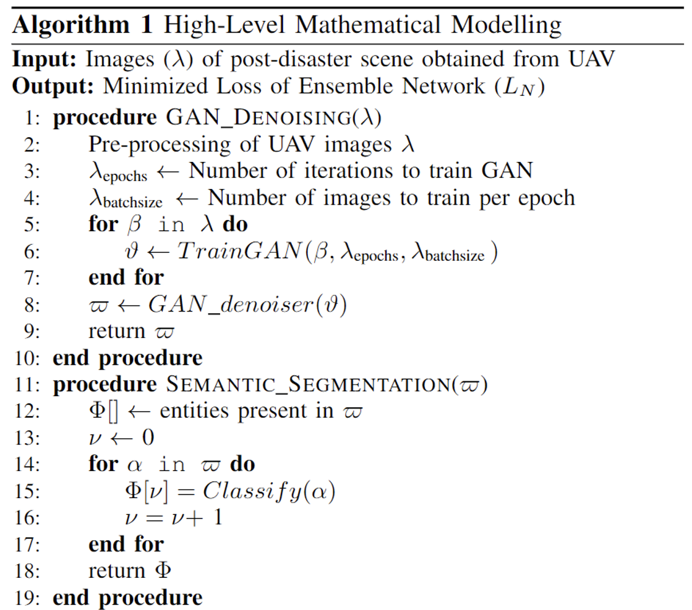
Mathematical Modelling Scope

Slide 9
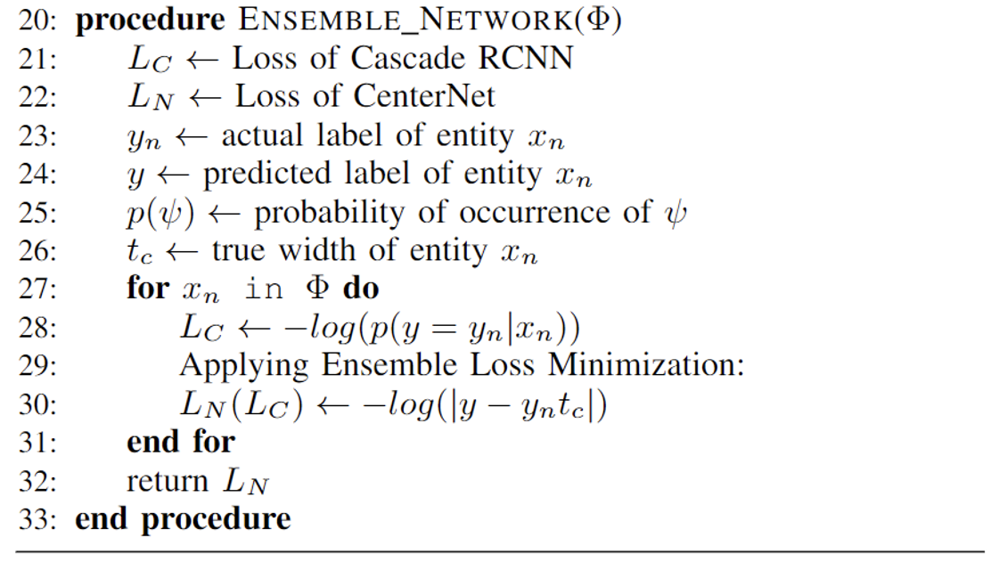
Mathematical Modelling Scope

Slide 10
Tentative Timeline
Task | Tentative Timeline
Data collection and initial tuning | Jan 25 to Feb 10
GAN + Semantic segmentation framework, 3D scene reconstruction mechanism | Feb 10 to Feb 25
Selection of optimal detection frameworks | Feb 25 to Mar 5
Implementation of a hybrid mechanism of the chosen single-stage and multi-stage detection frameworks | Mar 5 to Mar 20
Simulation of the system after integration of modules, performance testing, and evaluation | Mar 20 to Mar 30

Slide 11
References
T. Ye, W. Qin, Y. Li, S. Wang, J. Zhang and Z. Zhao, "Dense and Small Object Detection in UAV-Vision Based on a Global-Local Feature Enhanced Network," in IEEE Transactions on Instrumentation and Measurement, vol. 71, pp. 1-13, 2022
A. Bouguettaya, H. Zarzour, A. Kechida and A. M. Taberkit, "Vehicle Detection From UAV Imagery With Deep Learning: A Review," in IEEE Transactions on Neural Networks and Learning Systems, vol. 33, no. 11, pp. 6047-6067, Nov. 2022
Albaba, Berat Mert, and Sedat Ozer, "SyNet: An ensemble network for object detection in UAV images," in 25th IEEE International Conference on Pattern Recognition (ICPR), pp. 10227-10234, 2021
T. C. Bybee and S. E. Budge, "Method for 3-D Scene Reconstruction Using Fused LiDAR and Imagery From a Texel Camera," in IEEE Transactions on Geoscience and Remote Sensing, vol. 57, no. 11, pp. 8879-8889, Nov. 2019
H. Ren et al., "Swarm UAV SAR for 3-D Imaging: System Analysis and Sensing Matrix Design," in IEEE Transactions on Geoscience and Remote Sensing, vol. 60, pp. 1-16, 2022

Slide 12
References
M. Żarski, B. Wójcik, J. A. Miszczak, B. Blachowski and M. Ostrowski, "Computer Vision Based Inspection on Post-Earthquake With UAV Synthetic Dataset," in IEEE Access, vol. 10, pp. 108134-108144, 2022
Isaac-Medina, Brian KS, Matt Poyser, Daniel Organisciak, Chris G. Willcocks, Toby P. Breckon, and Hubert PH Shum. "Unmanned aerial vehicle visual detection and tracking using deep neural networks: A performance benchmark." In Proceedings of the IEEE/CVF International Conference on Computer Vision (ICCV), pp. 1223-1232. 2021.
J. Dong, K. Ota and M. Dong, "UAV-Based Real-Time Survivor Detection System in Post-Disaster Search and Rescue Operations," in IEEE Journal on Miniaturization for Air and Space Systems, vol. 2, no. 4, pp. 209-219, 2021
M. Rahnemoonfar, T. Chowdhury, A. Sarkar, D. Varshney, M. Yari and R. R. Murphy, "FloodNet: A High Resolution Aerial Imagery Dataset for Post Flood Scene Understanding," in IEEE Access, vol. 9, pp. 89644-89654, 2021

Slide 13
References
Rahnemoonfar, Maryam, Tashnim Chowdhury, and Robin Murphy. "RescueNet: A High Resolution Post Disaster UAV Dataset for Semantic Segmentation." UMBC Student Collection (2021).
T. Chowdhury and M. Rahnemoonfar, "Attention Based Semantic Segmentation on UAV Dataset for Natural Disaster Damage Assessment," 2021 IEEE International Geoscience and Remote Sensing Symposium IGARSS, pp. 2325-2328, 2021
Li, Tianjiao, Jun Liu, Wei Zhang, Yun Ni, Wenqian Wang, and Zhiheng Li. "Uav-human: A large benchmark for human behavior understanding with unmanned aerial vehicles." In Proceedings of the IEEE/CVF Conference on Computer Vision and Pattern Recognition (CVPR), pp. 16266-16275, 2021

